Slide 1
Stoic Gasa
Cheng Wah Man
Lee Kun Tat
Marcus Cheong Wai Keong
Ng Wee Thia Joel
CS3247 Game Concept Presentation

Slide 2
What is Stoic Gasa?
Genre: Arcade Shooter / Puzzle
Platform: Samsung Tablet with S-pen
Target Audience: Young kids to Teens

Slide 3


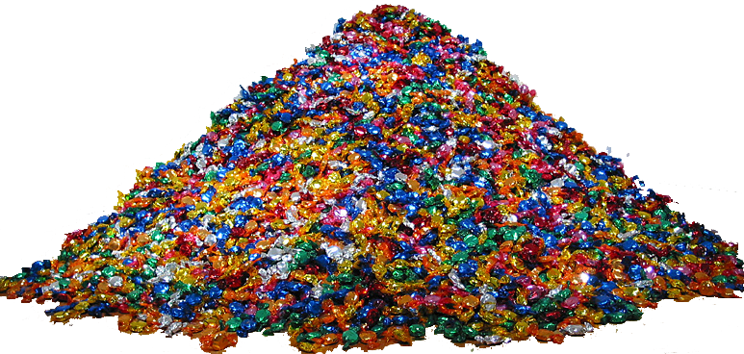
Evil King

Slide 4
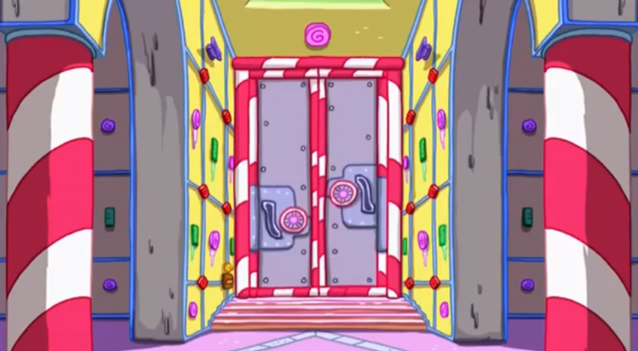
Candy Vault

Slide 5

The kids were like...
Y U So Bad One…?

Slide 6


Stoic

Slide 7
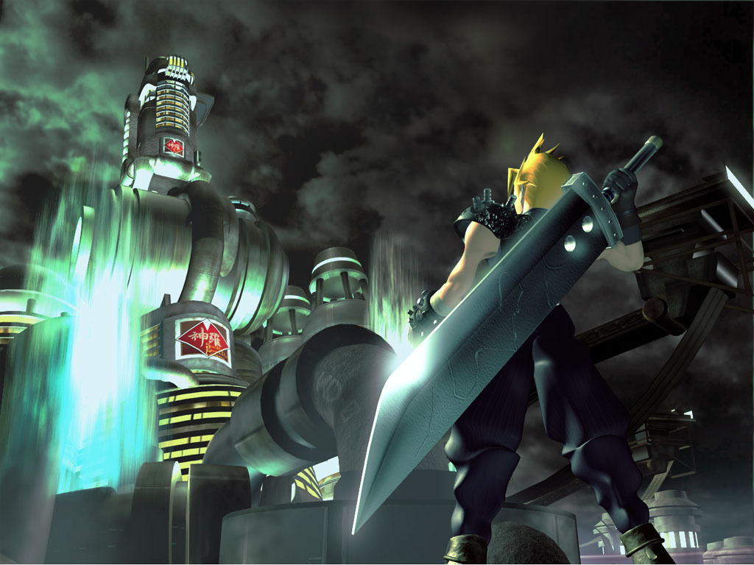
The Quest Begins

Slide 8
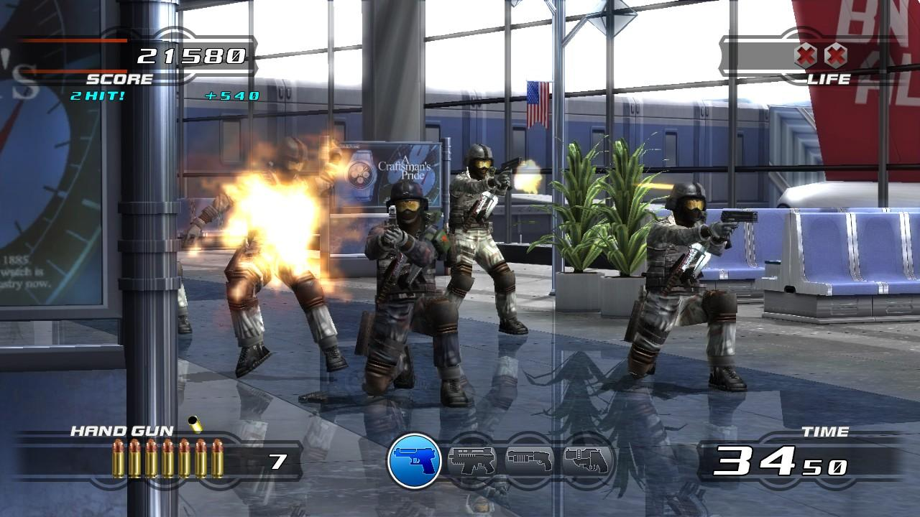
Arcade Shooting - Time Crisis
Shoot enemies that appear
Guard from bullets
Scoring system
Bullet management
Weapon change
Limited time

Slide 9

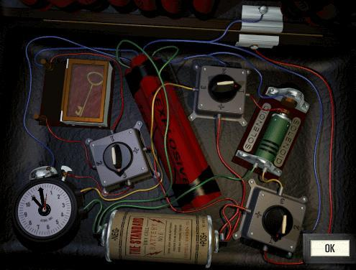
Mini-games

Slide 10
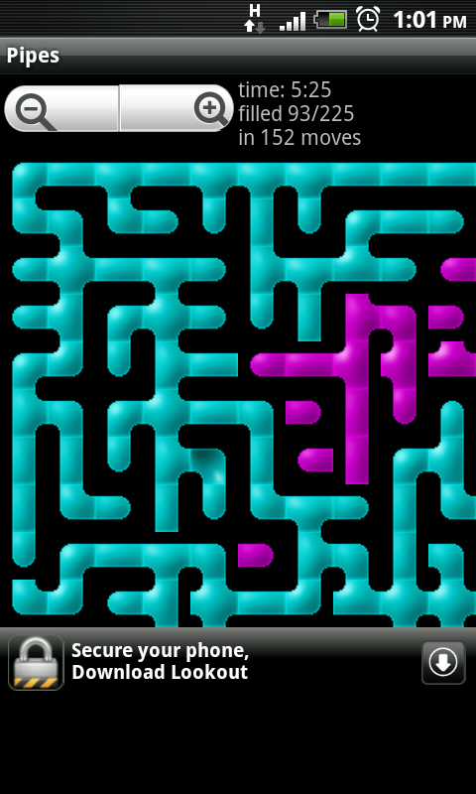
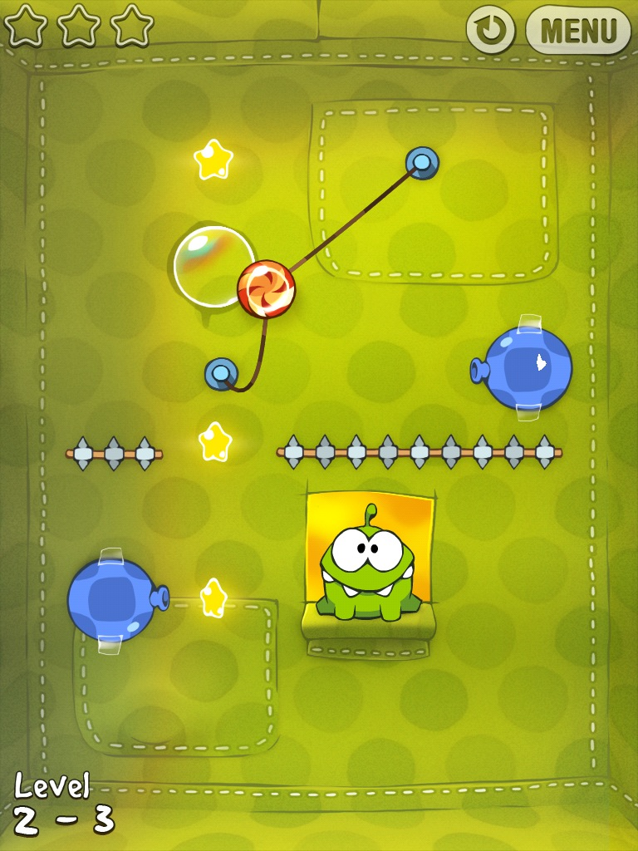
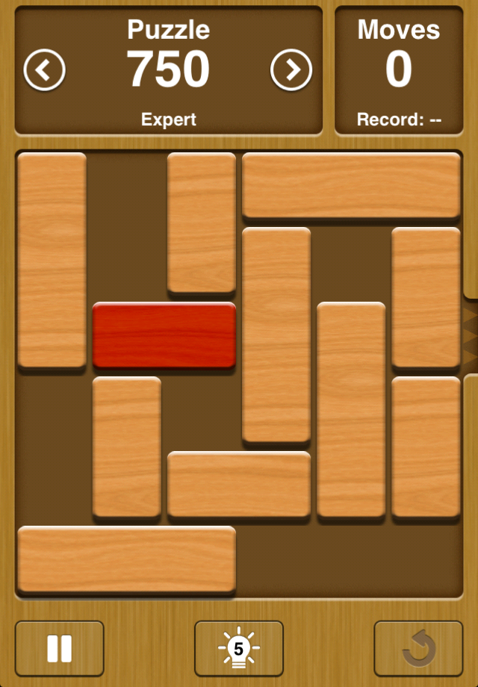
Minigames

Slide 11

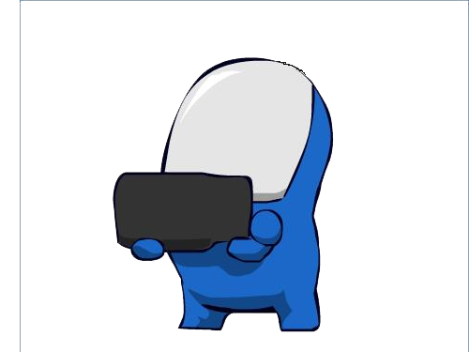

Art Style
Comedic
Cartoony
Cutesy

Slide 12
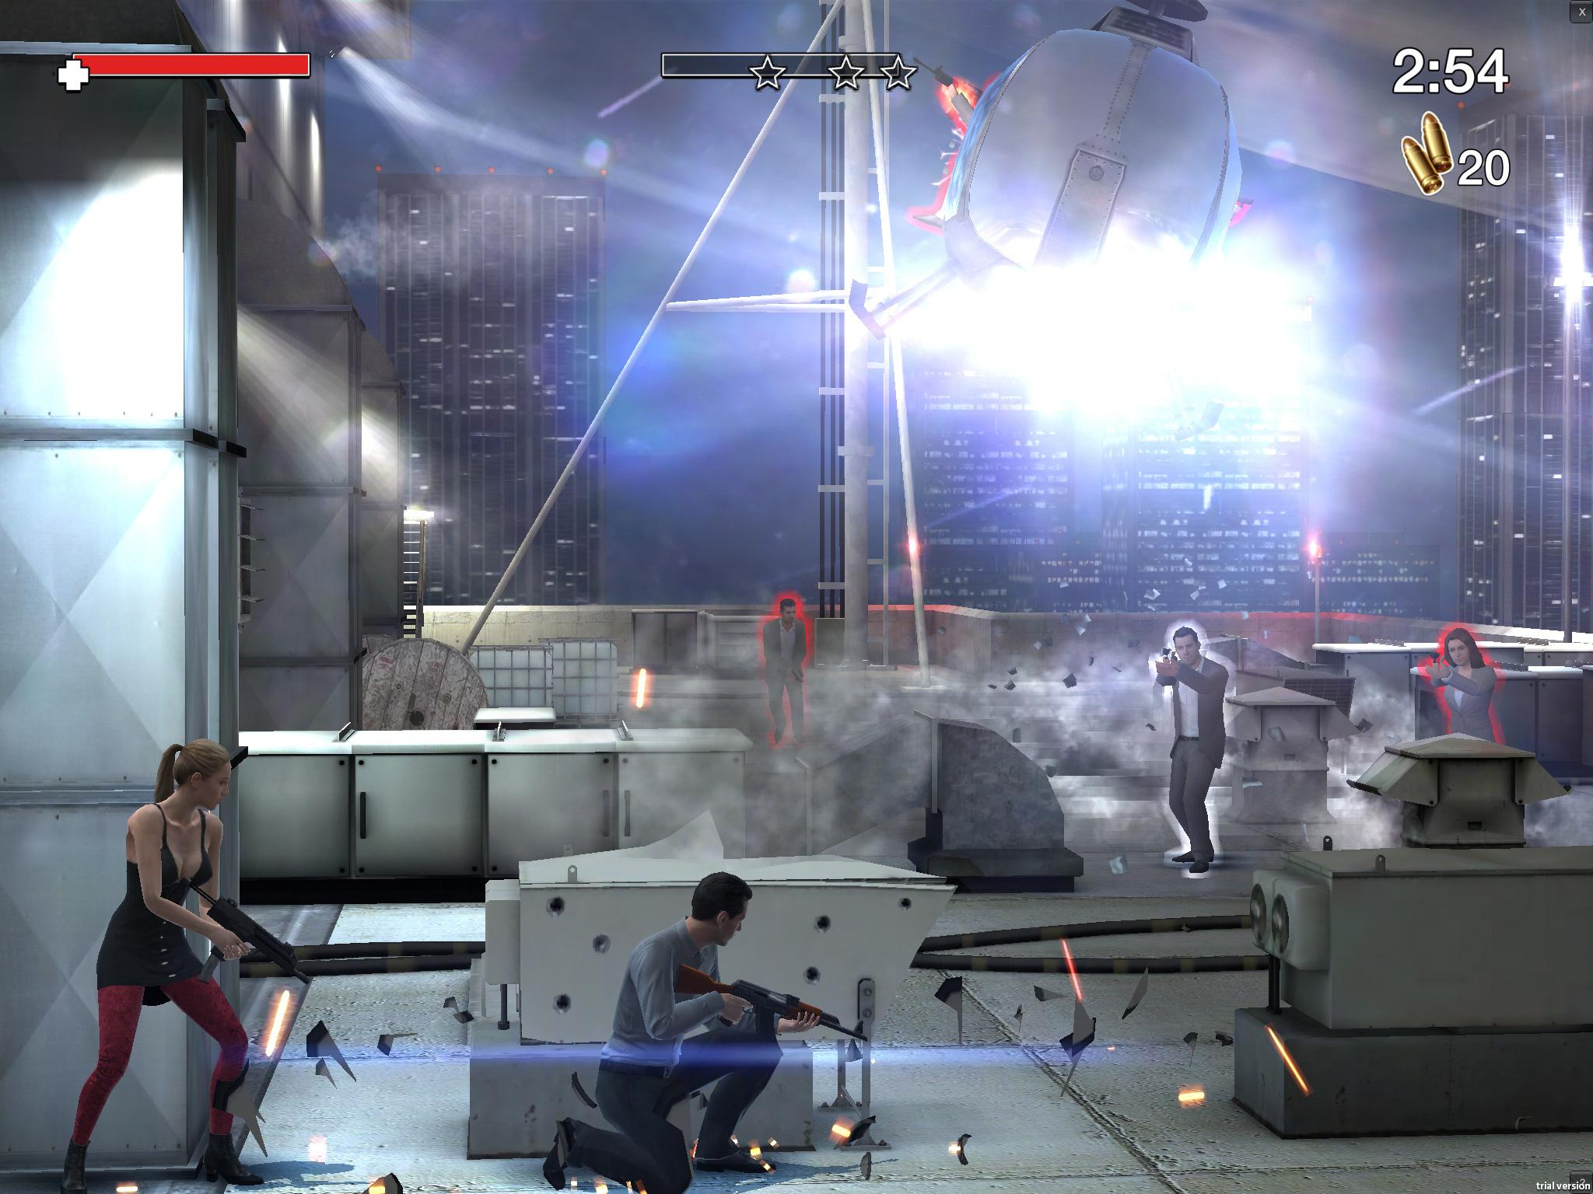
Demo Video - Lawless

Slide 13
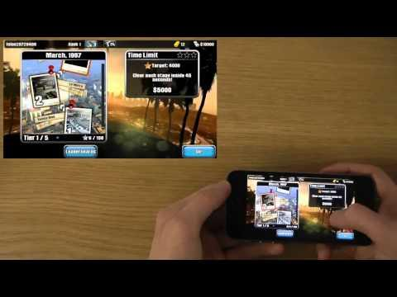
Demo Video - Lawless

Slide 14
THE END
Hope you enjoyed our presentation! :)

